Slide 1
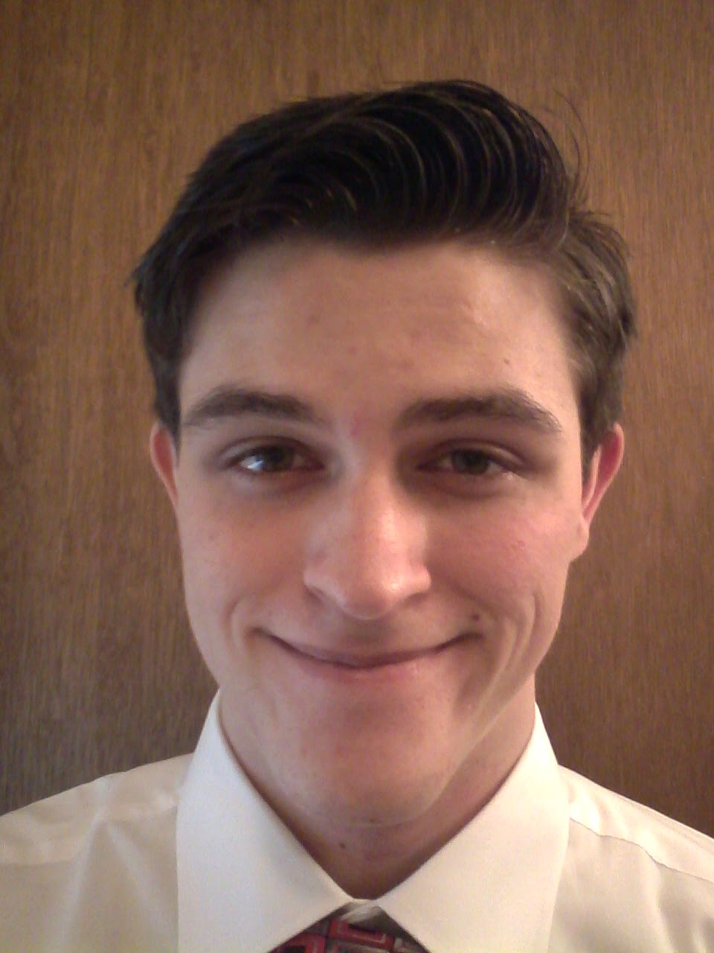
Digital Portfolio
Although not limited to one style, genre, or technique, preference lies in drawing things from imagination and fantasy instead of life.
Pic of me
Sebastian Crowell

Slide 2
Artist Statement
The purpose for creating artwork is to create a reaction in people. My work is an extension of creative talent and current popular themes as well as traditional techniques. A majority of my pieces are influenced by video games, movies, and books including but not limited to images and motifs.

Slide 3
Sketchbook cover
A Soldier
Ink on paper
8.5 x 11 inches
3 Colors, Negative Space, Emphasis, Contrast, Size
Star Wars
I created it before the release of the recent Star Wars movie using a single still frame from a scene. Before sketching I zoomed in on his face instead of his full body. After it was drawn with the blue ballpoint pen, the red was added to create a contrast between the light, shadow, highlights and midtones. To make deeper shadows, I took the ballpoint and cross hatched some areas.

Slide 4
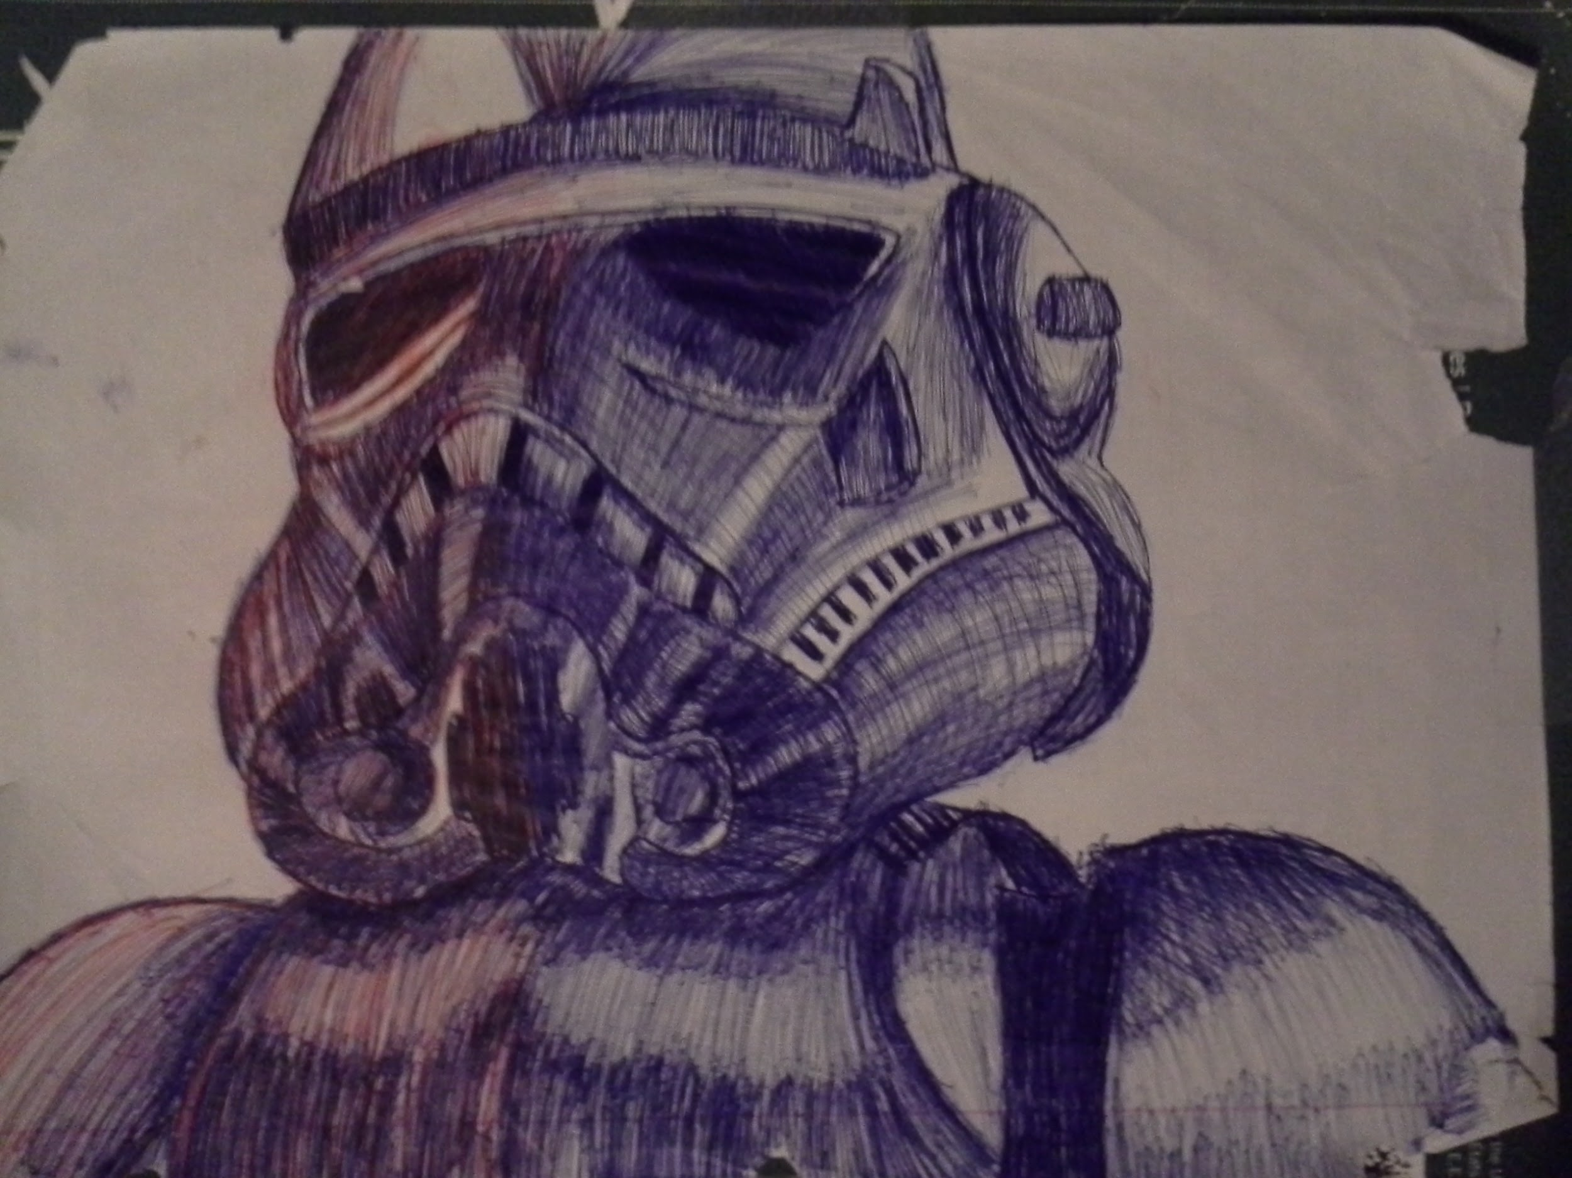

Slide 5
Crane Sketch
Saturation
Pen and Marker on paper
9 x 12 inches
3 colors, Deep shadows, Unity, Emphasis, Contrast, Etc.
Origami pieces the class made
It was test to see where my ballpoint pen drawing skill was currently. The sketch is a great rendition of the two paper cranes. For this piece I drew a lot of inspiration from some anonymous artists on deviantart.

Slide 6
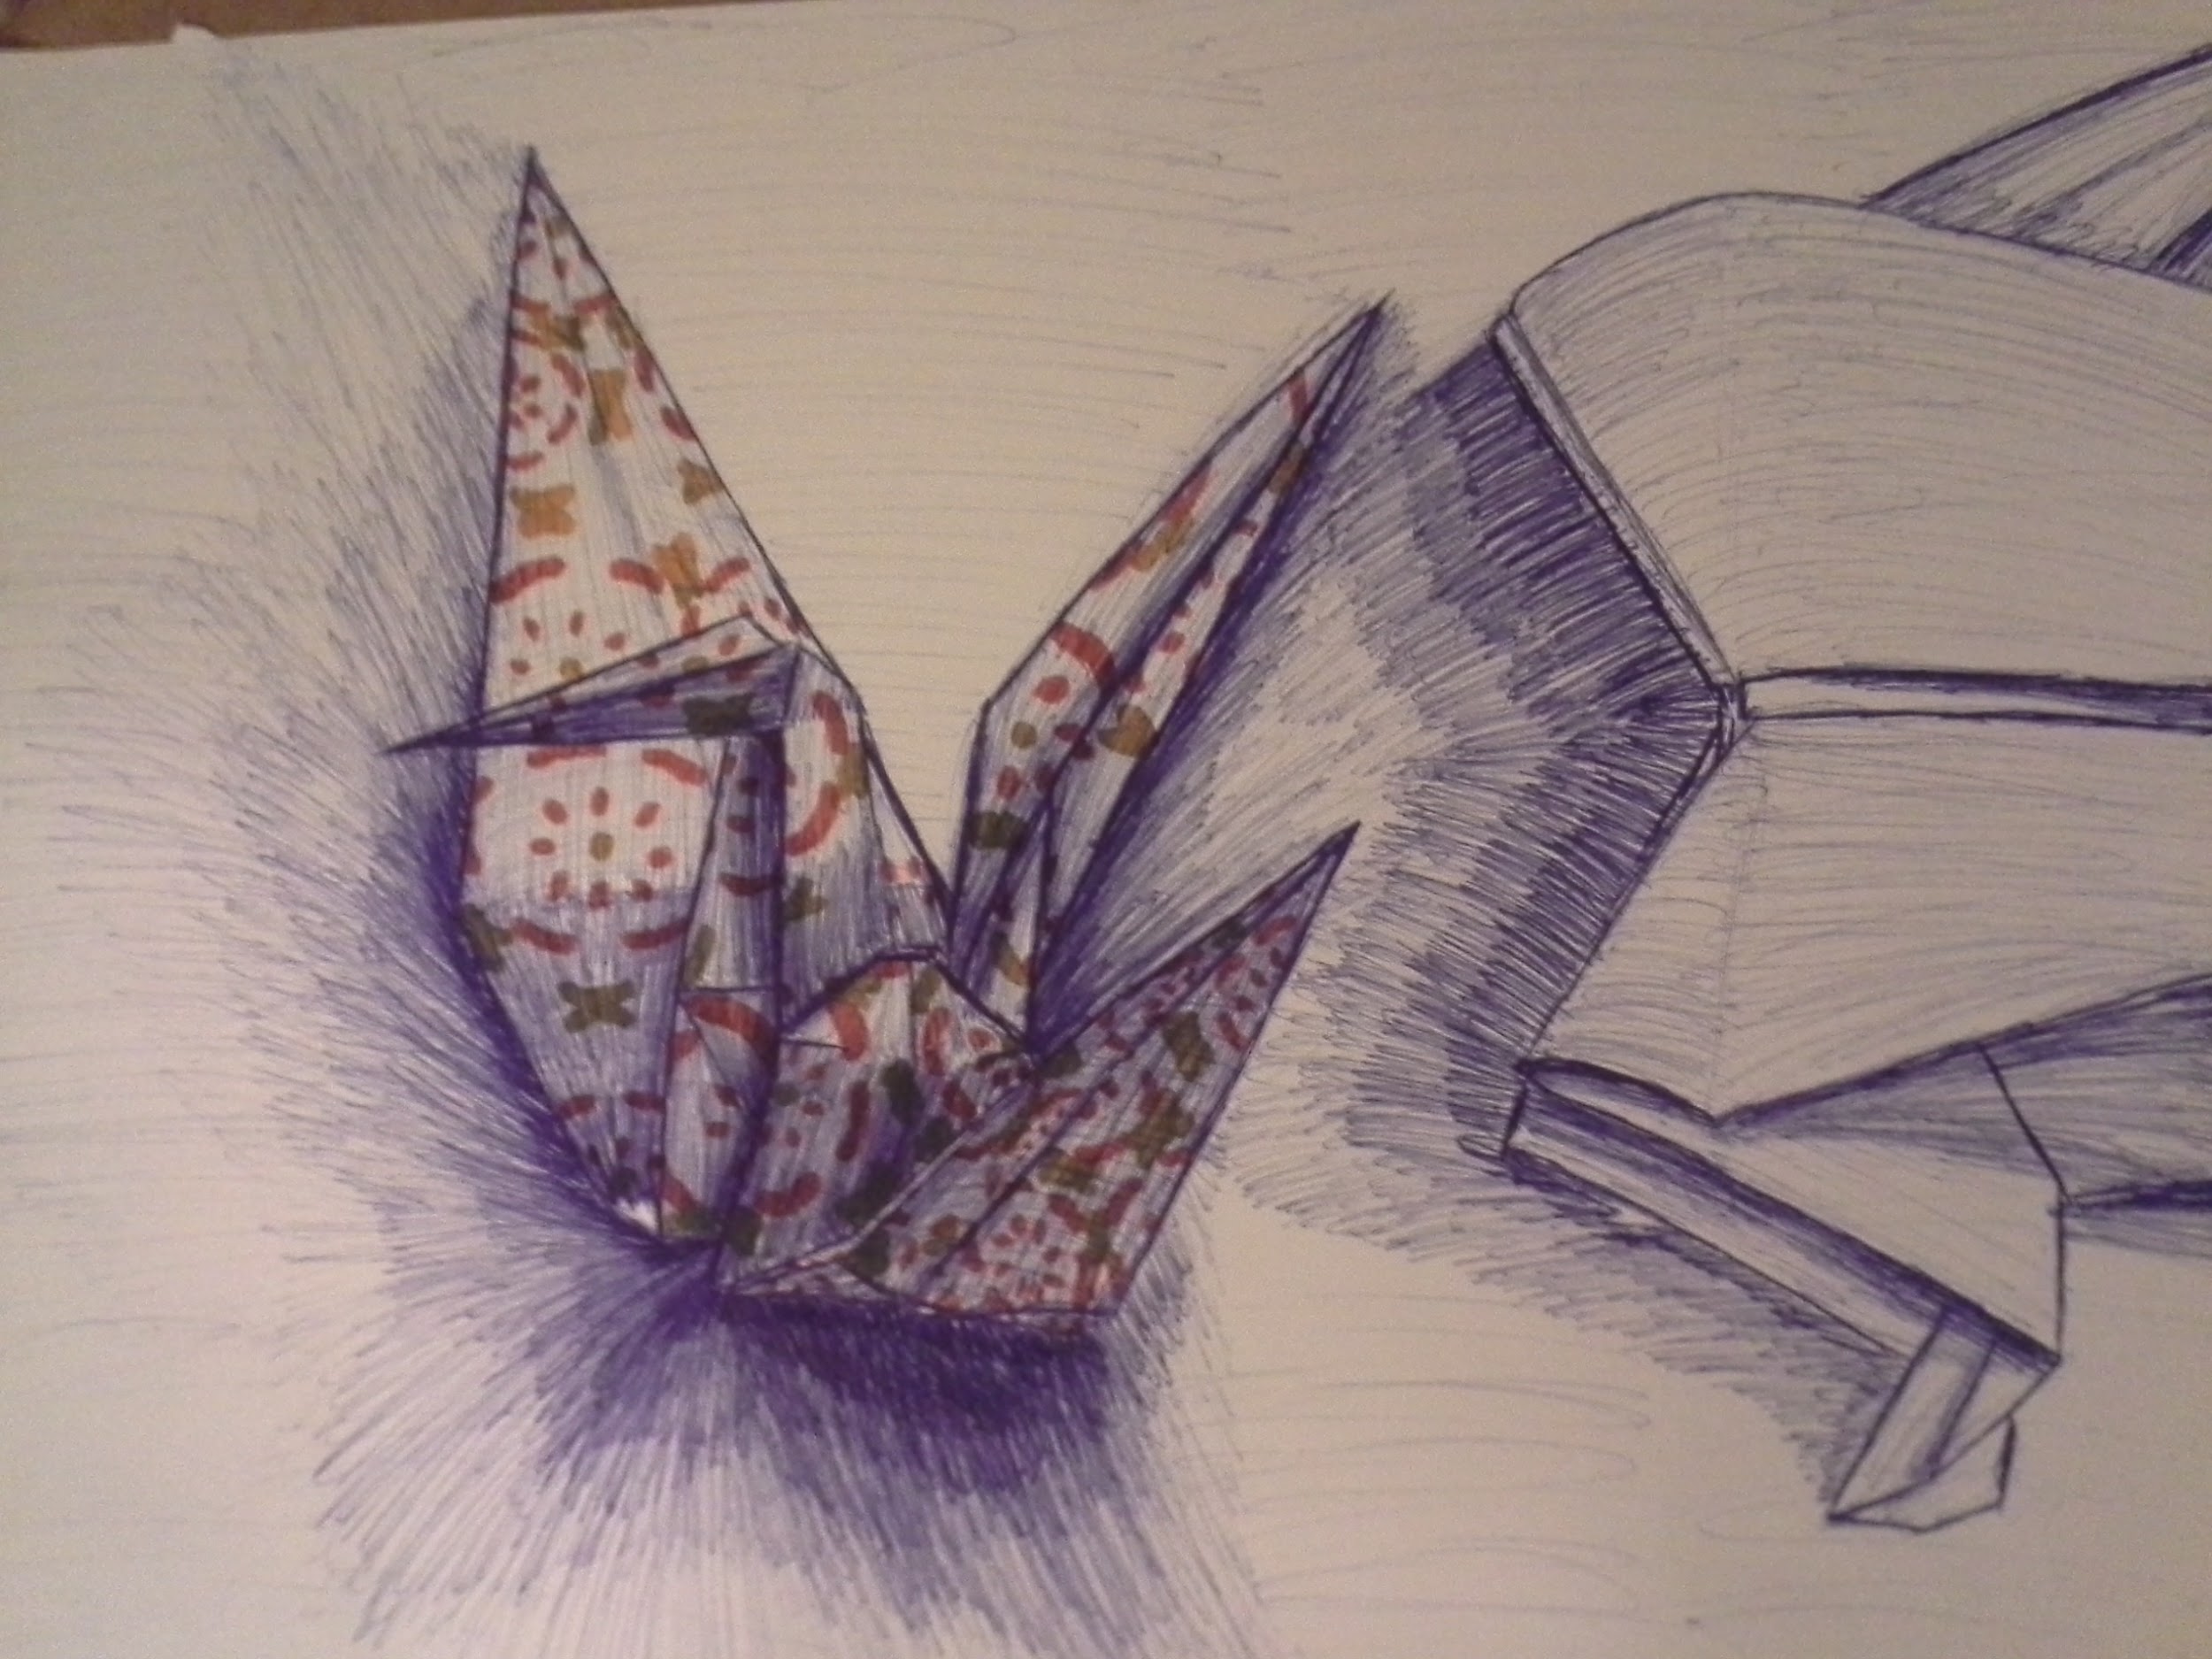

Slide 7
Da Vinci drawing
Grayed by Time
Ink on paper
9 x 12 inches
2 Colors, Negative Space, Contrast, Scale, Size
Da Vinci
To test my sketching skill with pen of portraits. This is a continuation of my ballpoint pen sketches. An image of a black and white Leonardo was used for reference. The biggest problem for me while sketching was creating the hair.

Slide 8
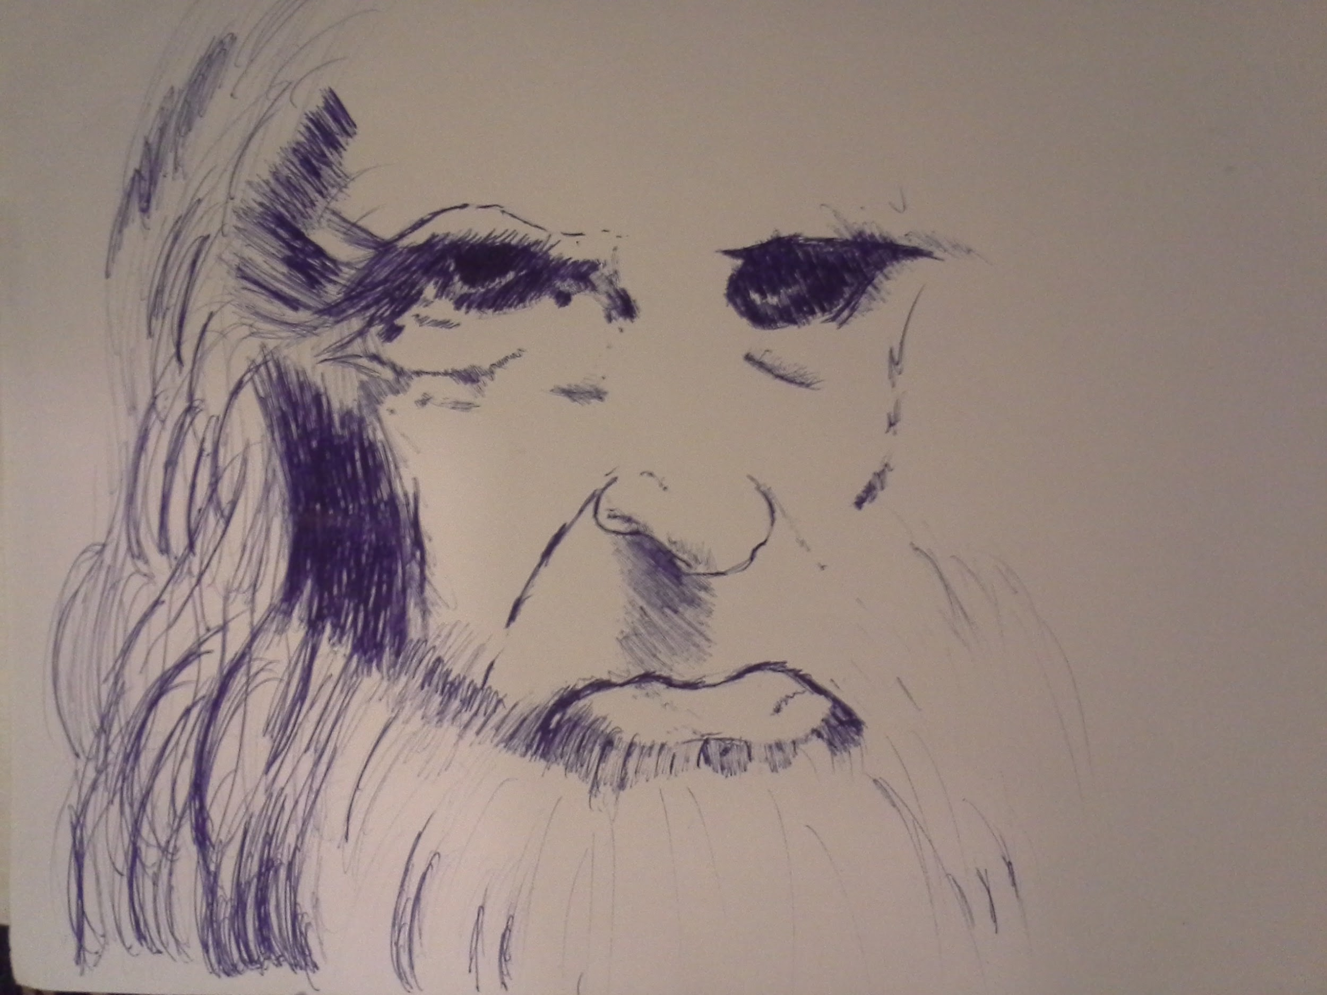

Slide 9
Rhino
Focus of the Wild Eyes (Recreation of Albrecht Durer’s Rhino)
Paint Marker and Sharpie
9 x 12 inches
Silver, Black, and Gold
Albrecht Durer
Use metal colored and textured markers to create a detailed work. The piece started as a fine point marker outline with Albrecht’s original piece In black and white. The gold and silver maker covered most of the black and required the outline to be redone once It dries.

Slide 10
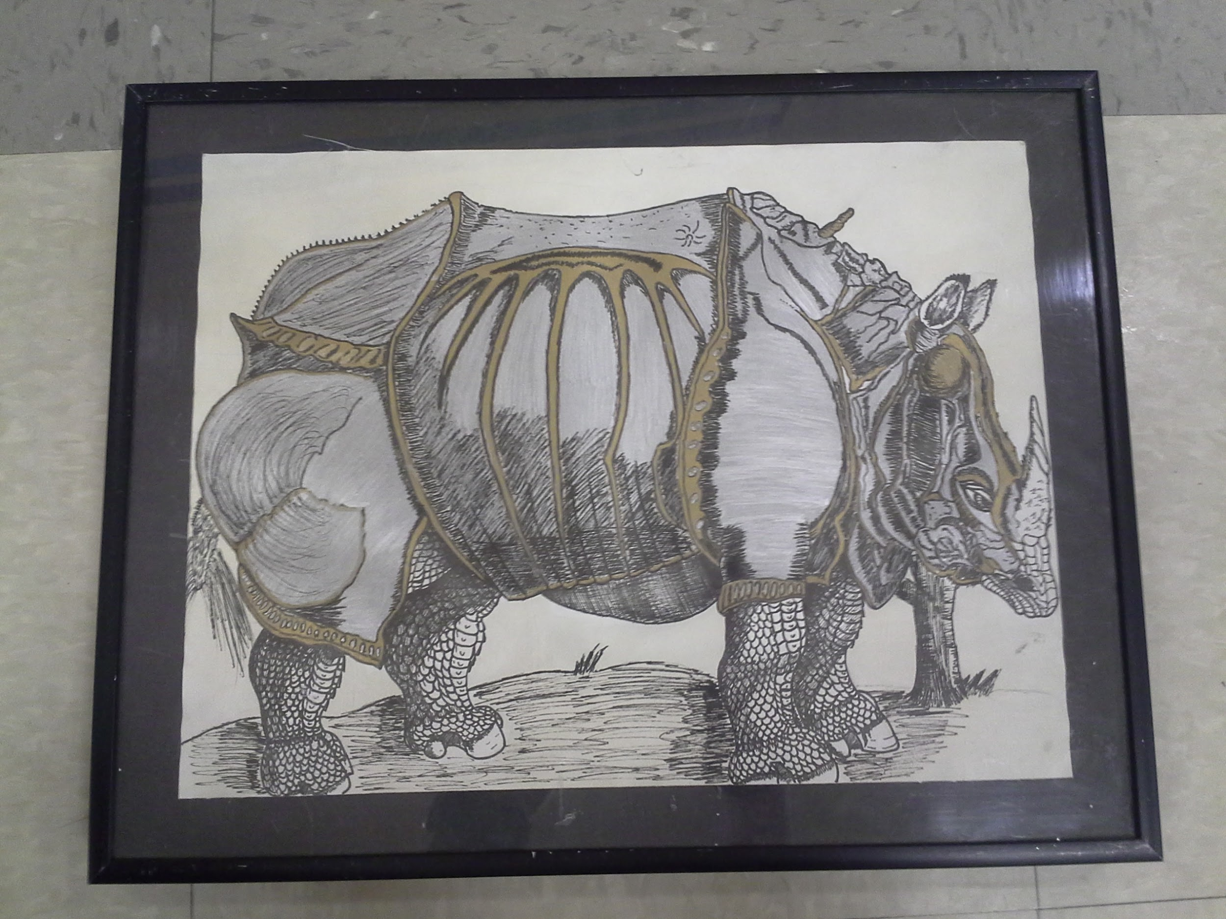

Slide 11
Surrealist Project
Lost in the Dessert
Graphite and Colored pencil on poster board and paper
Unknown
Multi Color, Size, Unity, Balance, Translocation, Levitation, Etc.
René Magritte, Salvador Dali
Creating an interesting piece of art using random items from everyday life. The first few images were decent but I drew two extras that ended up In the final. The realistic and fantastical themes mixed In the drawing creates the surreal feeling.

Slide 12
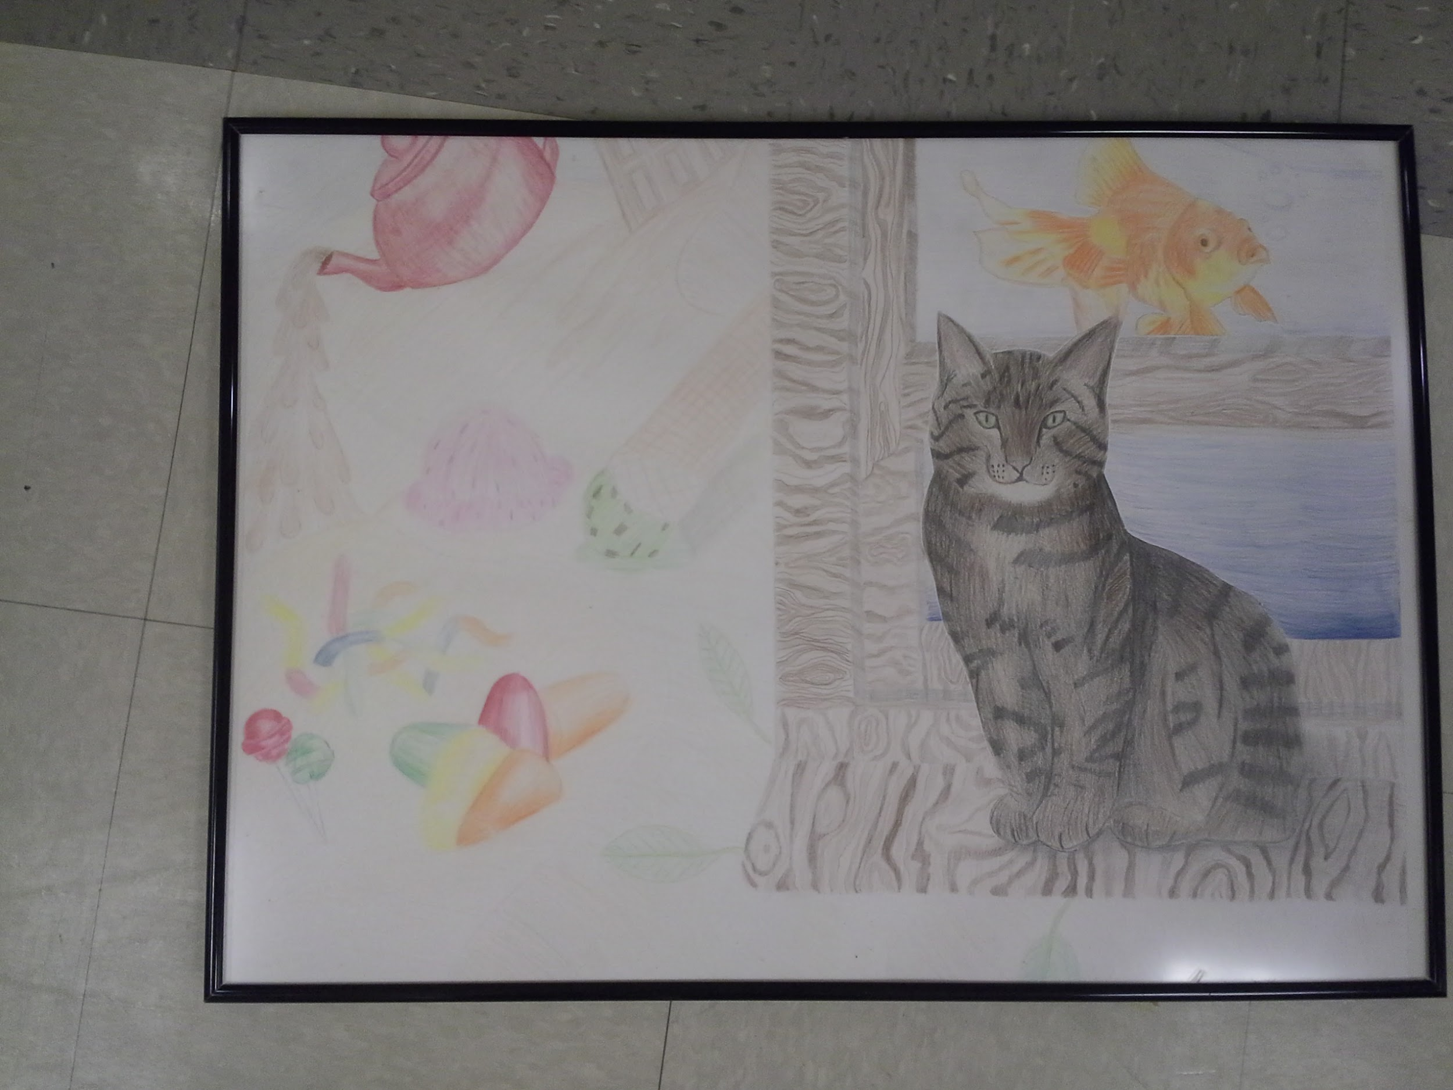

Slide 13
Teapot Final
Flower Pot
Clay and Glaze
Unknown
3 Colors
Ms. Murphy’s example
To try and better understand the clay techniques

Slide 14
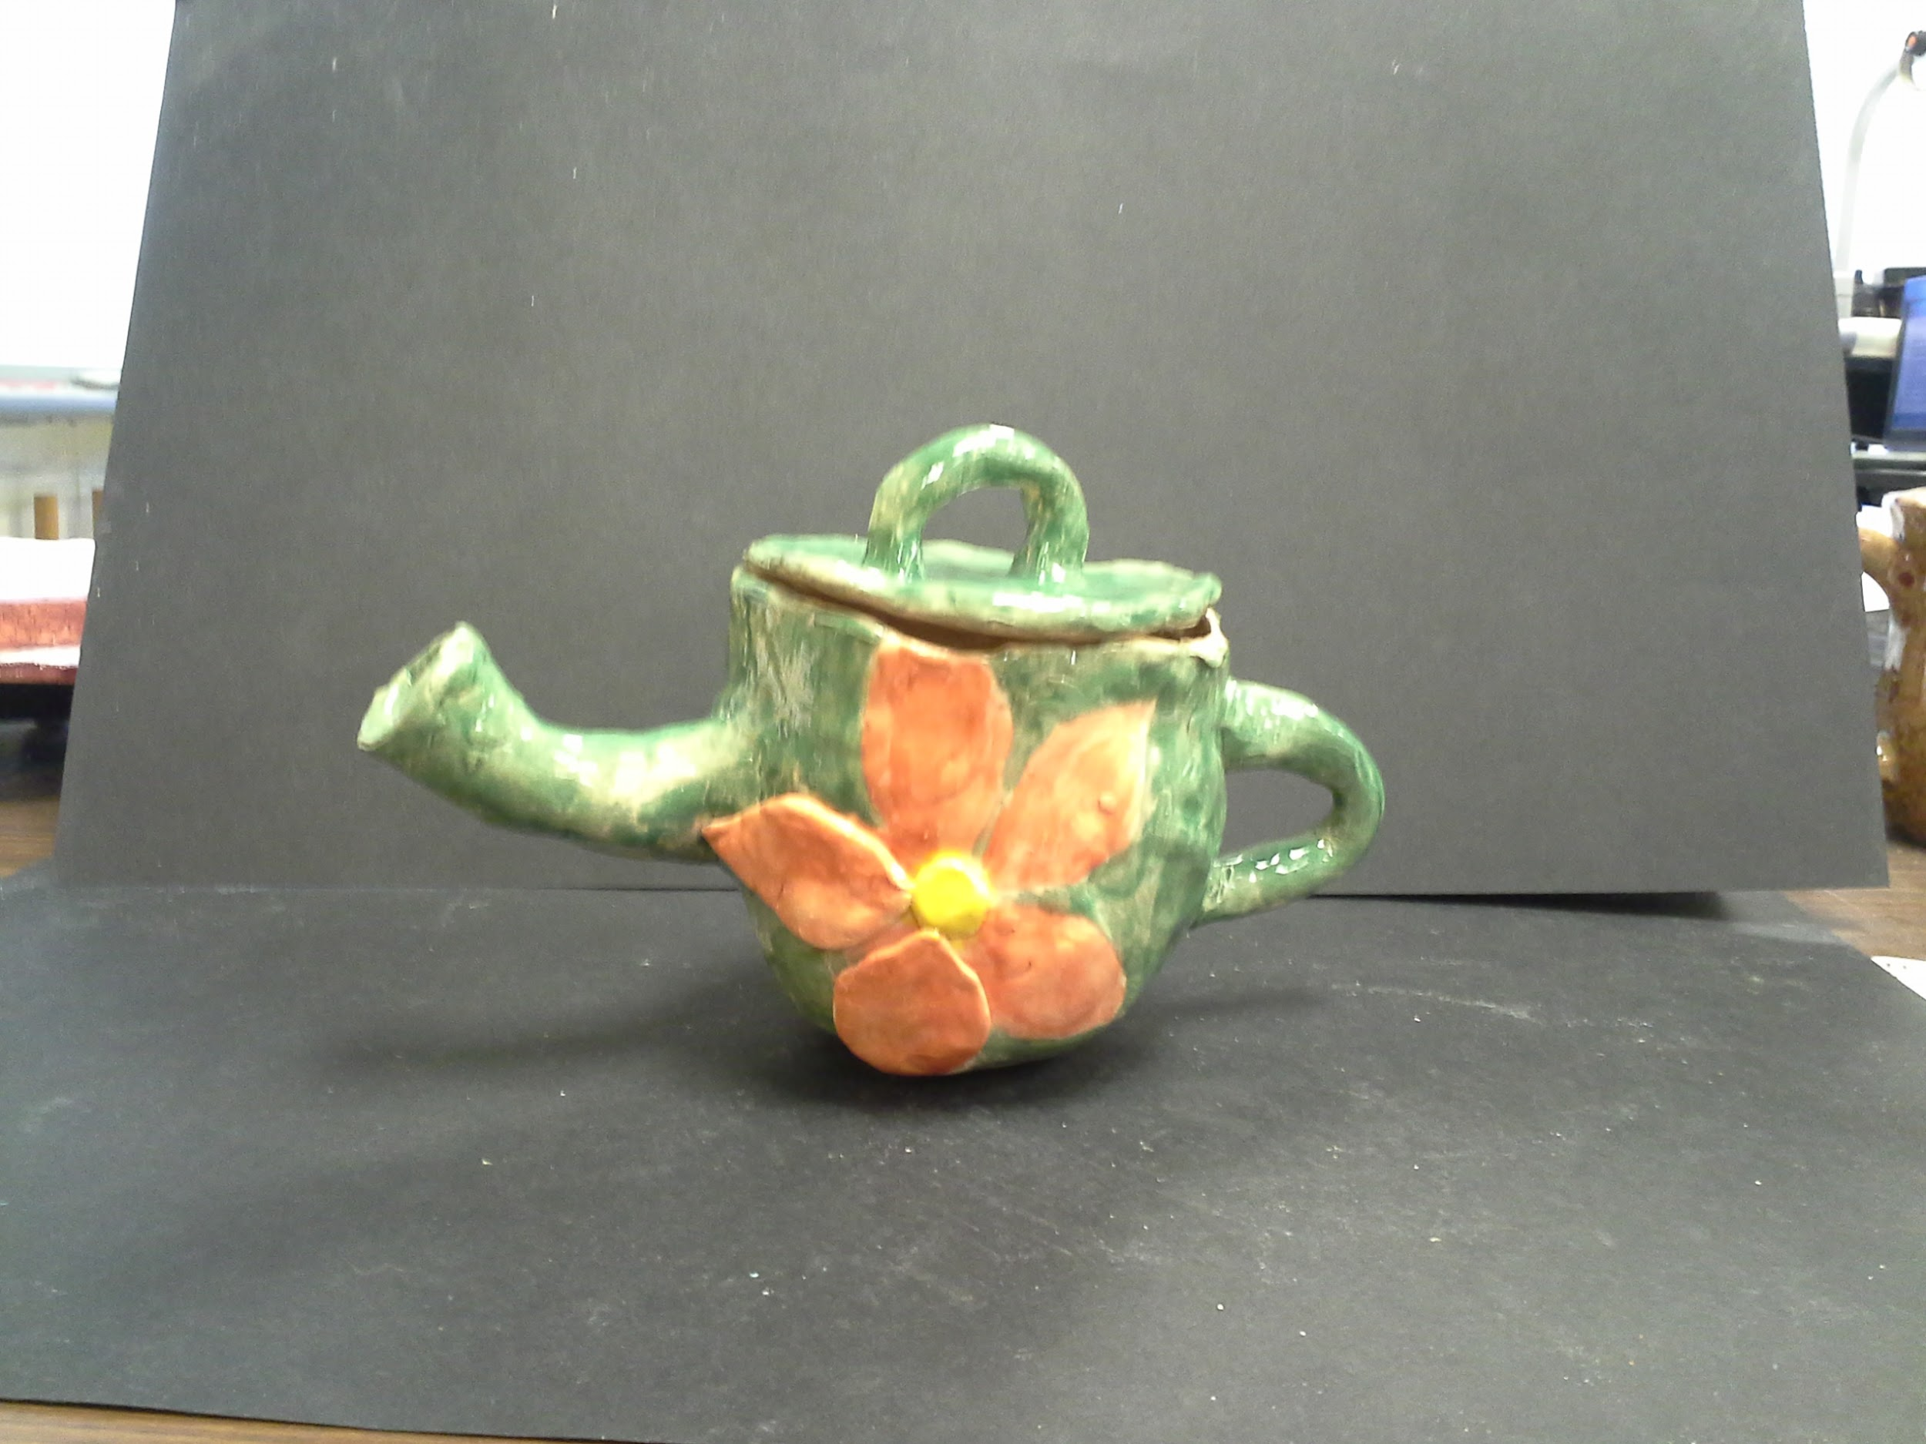
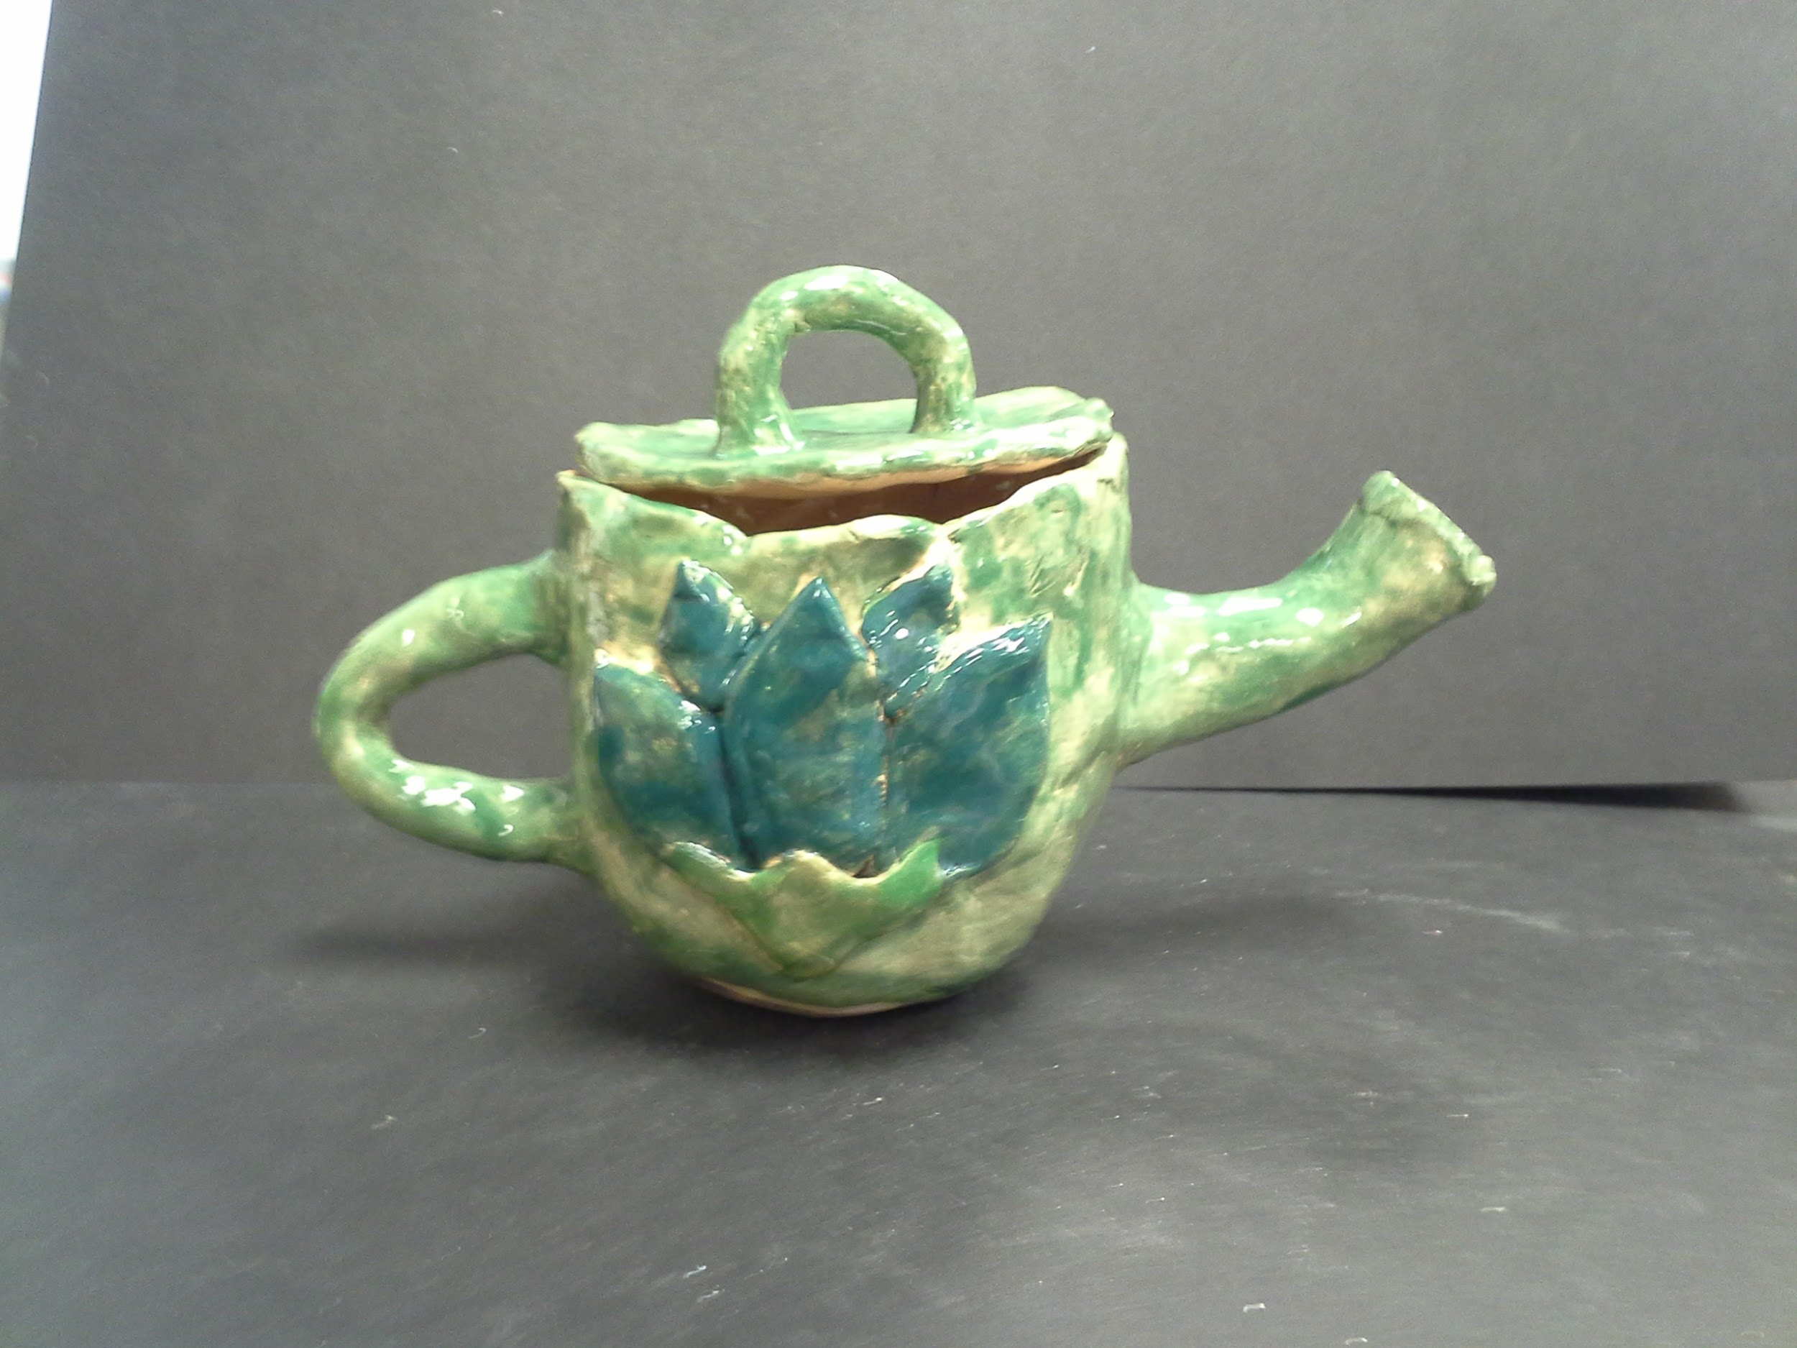

Slide 15
Project Grad Design
Jolly Graduate
Sharpie on paper
8 x 16 inches
Black and White, Contrast, Emphasis
Pirates
For the enjoyment of testing a mixture of vector and traditional art

Slide 16
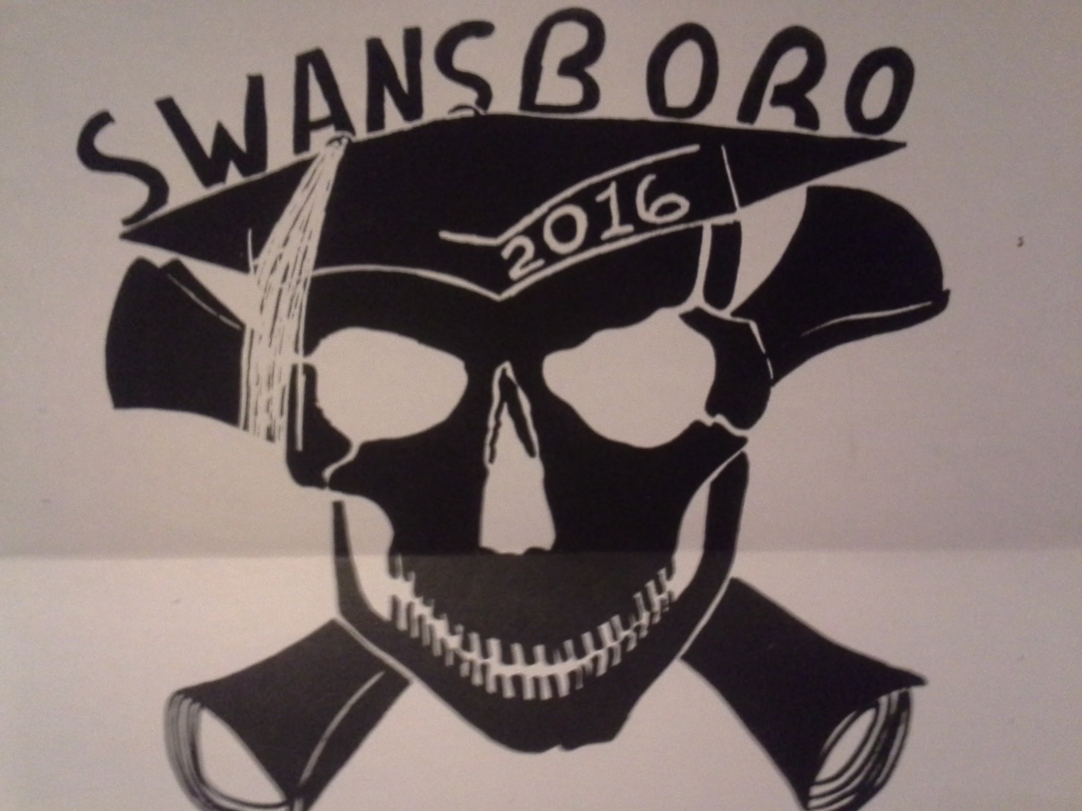

Slide 17
Mini Painting
Homage to Persistence of Memory
Oil painting on canvas
2.5 x 2.5 Inches
Mixed Colors, Surrealist Techniques, Focus
Salvador Dali
A test of painting prowess and an interesting piece to recreate. The painting is around six to seven layers thick. Many of the layers were to fix places where paint smudged or dripped. For me this was extremely difficult due to the fact I do not paint often and it was oil paints.

Slide 18
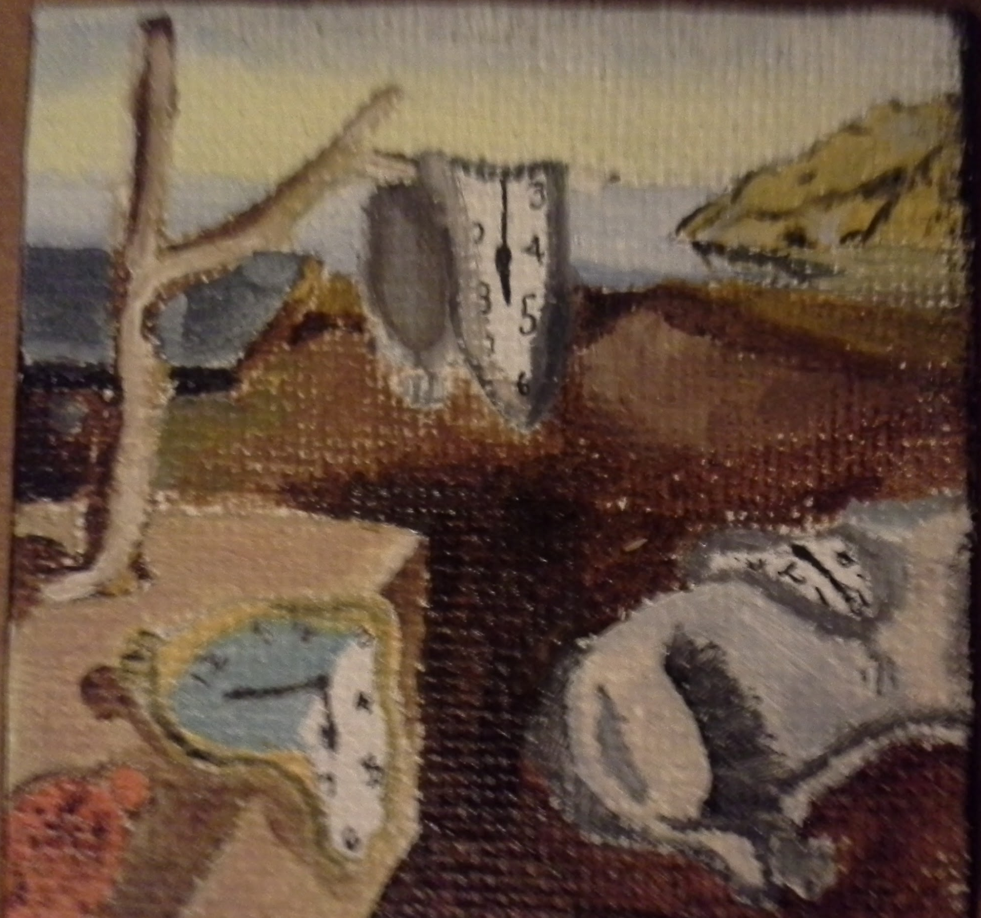

Slide 19
Chinese Paper Cut
Leopard of the Wild
Paper cutout, Spray paint
12 x 12 inches
Red and White paper, Balance, Unity, Scale, Size, Etc.
Traditional oriental style
Push myself to the limit of detail and design. This is not technically finished right now because of the extensive detail Involoved. My design follows another traditional oriental pattern but instead uses negative space to define the objects. This is perhaps the most difficult but interesting of all the projects.

Slide 20
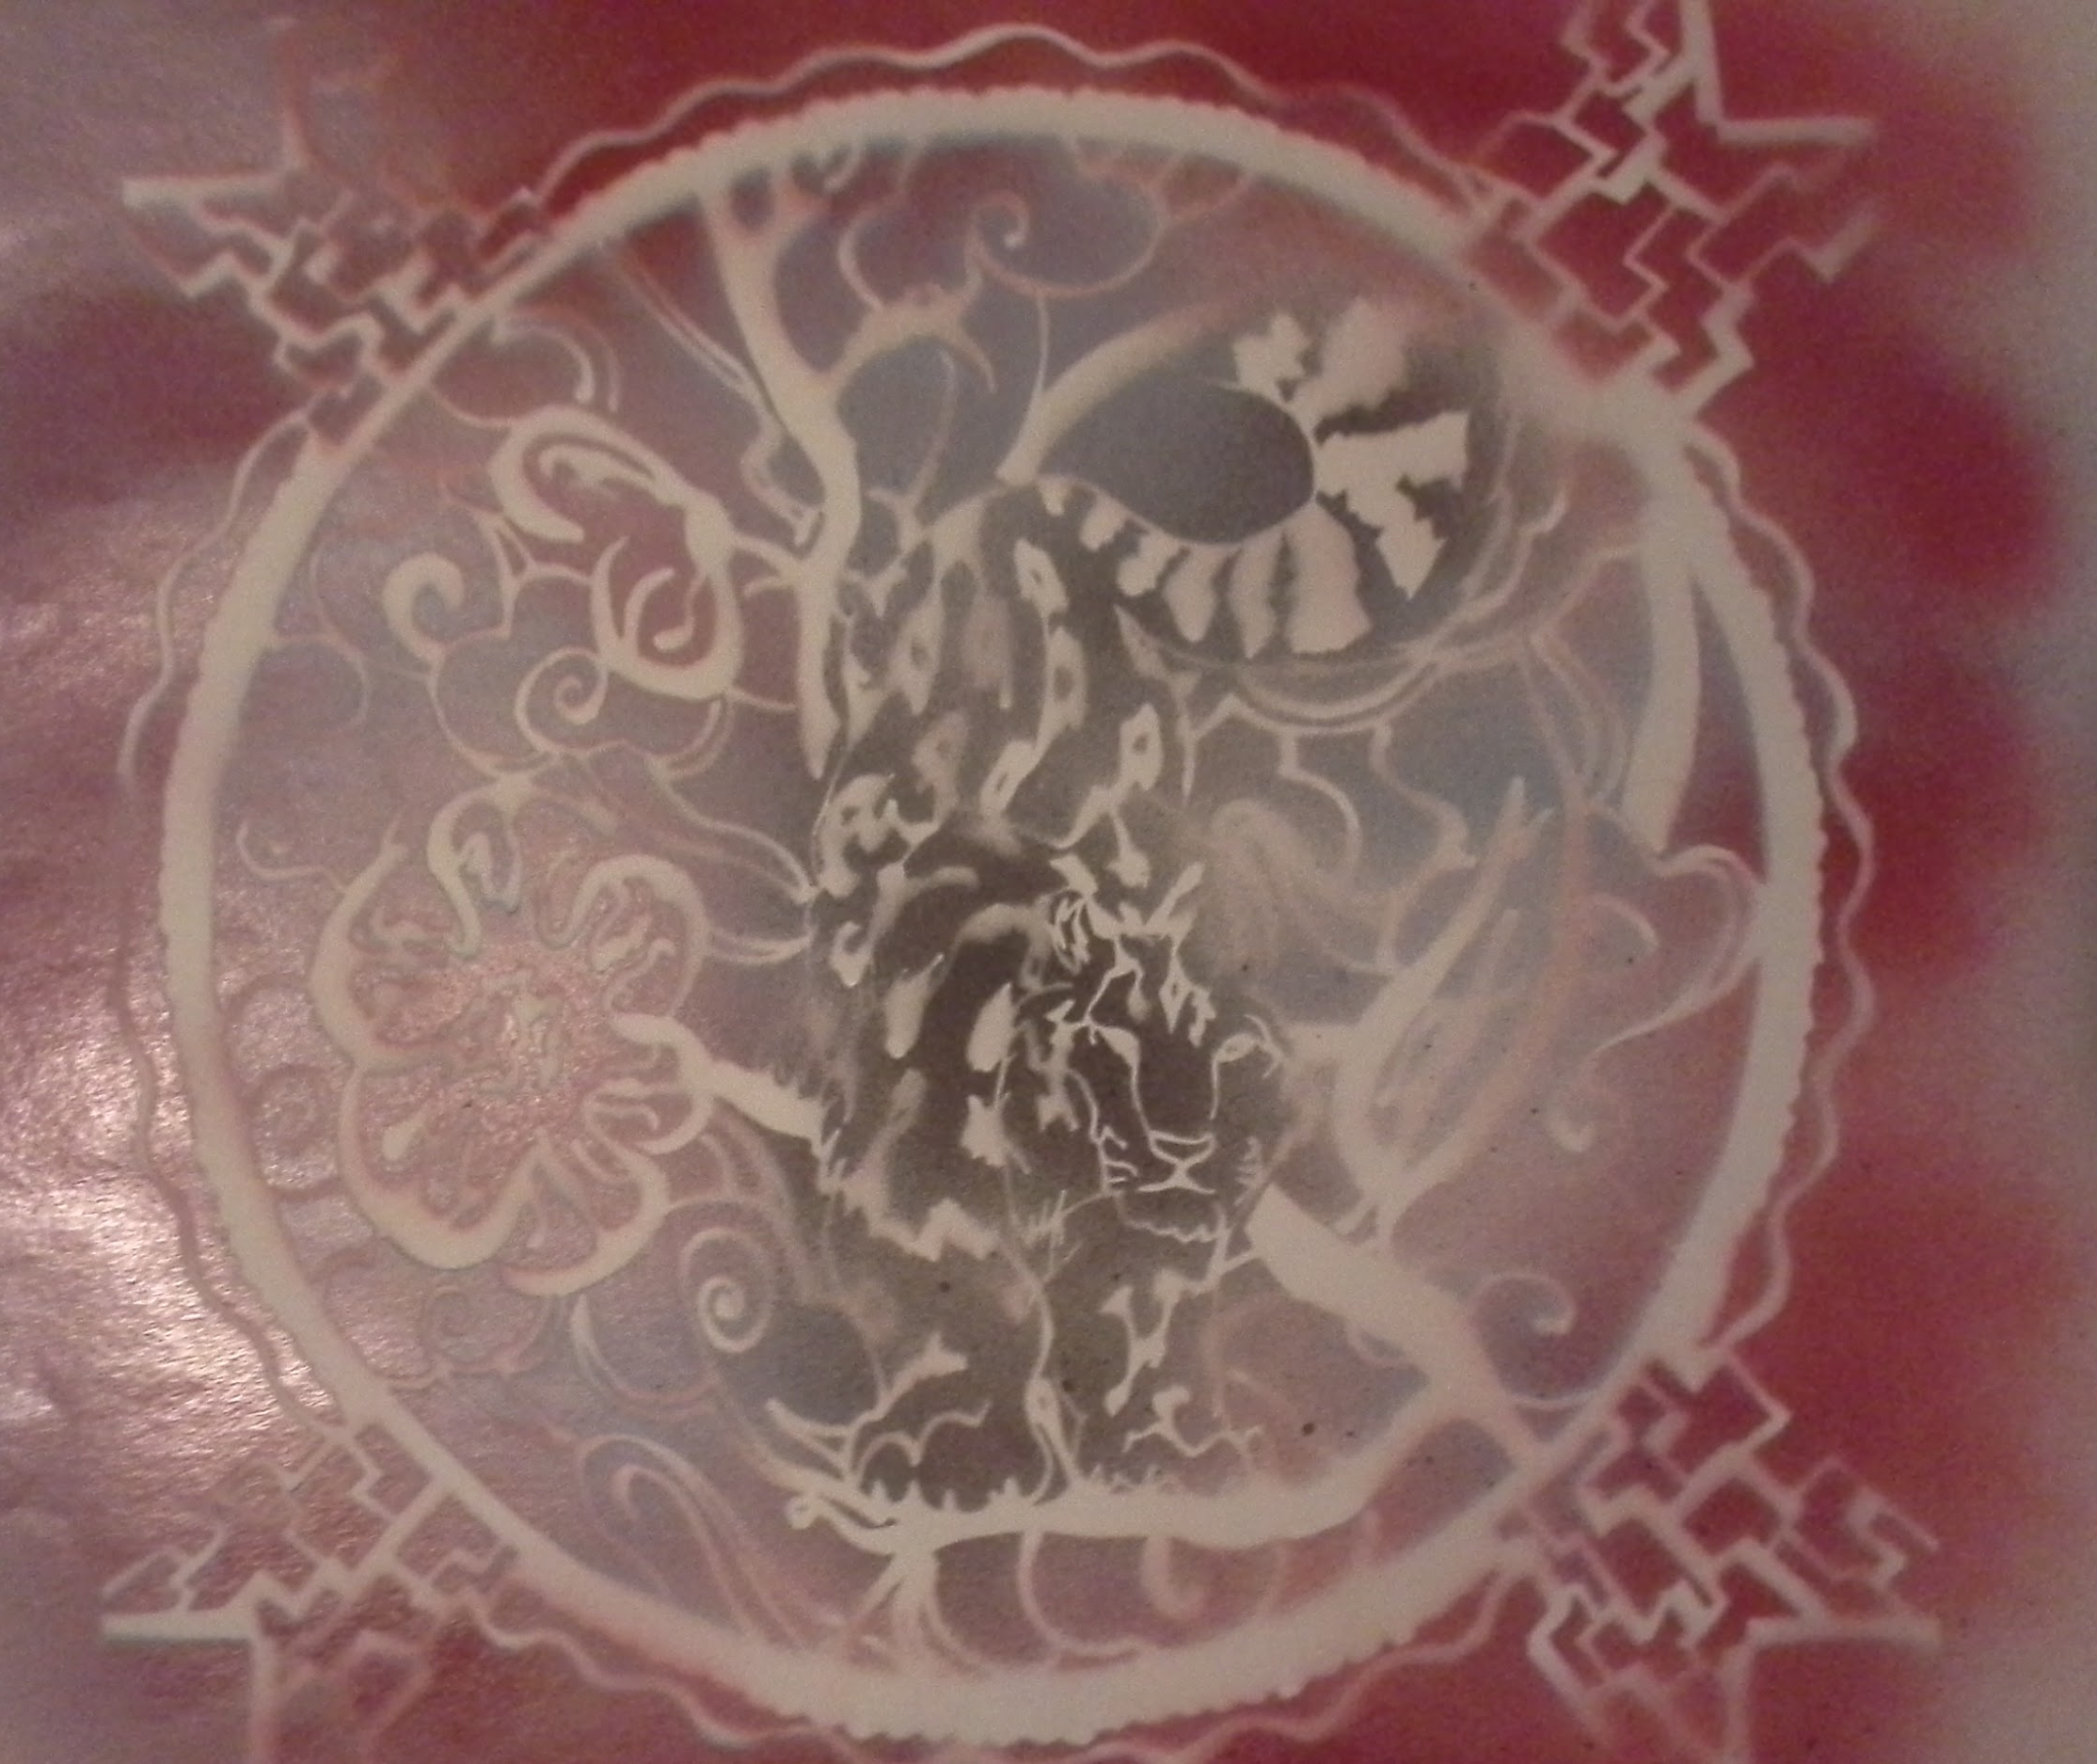

Slide 21
Ceramic Sqraffitto Bowl
Fish Bowl
Clay and Glaze
Unknown
Multi colored bowl, Balance, Unity, Uniform, Etc.
Contemporary oriental artwork
Using scratching techniques in clay to create a yin-yang design

Slide 22
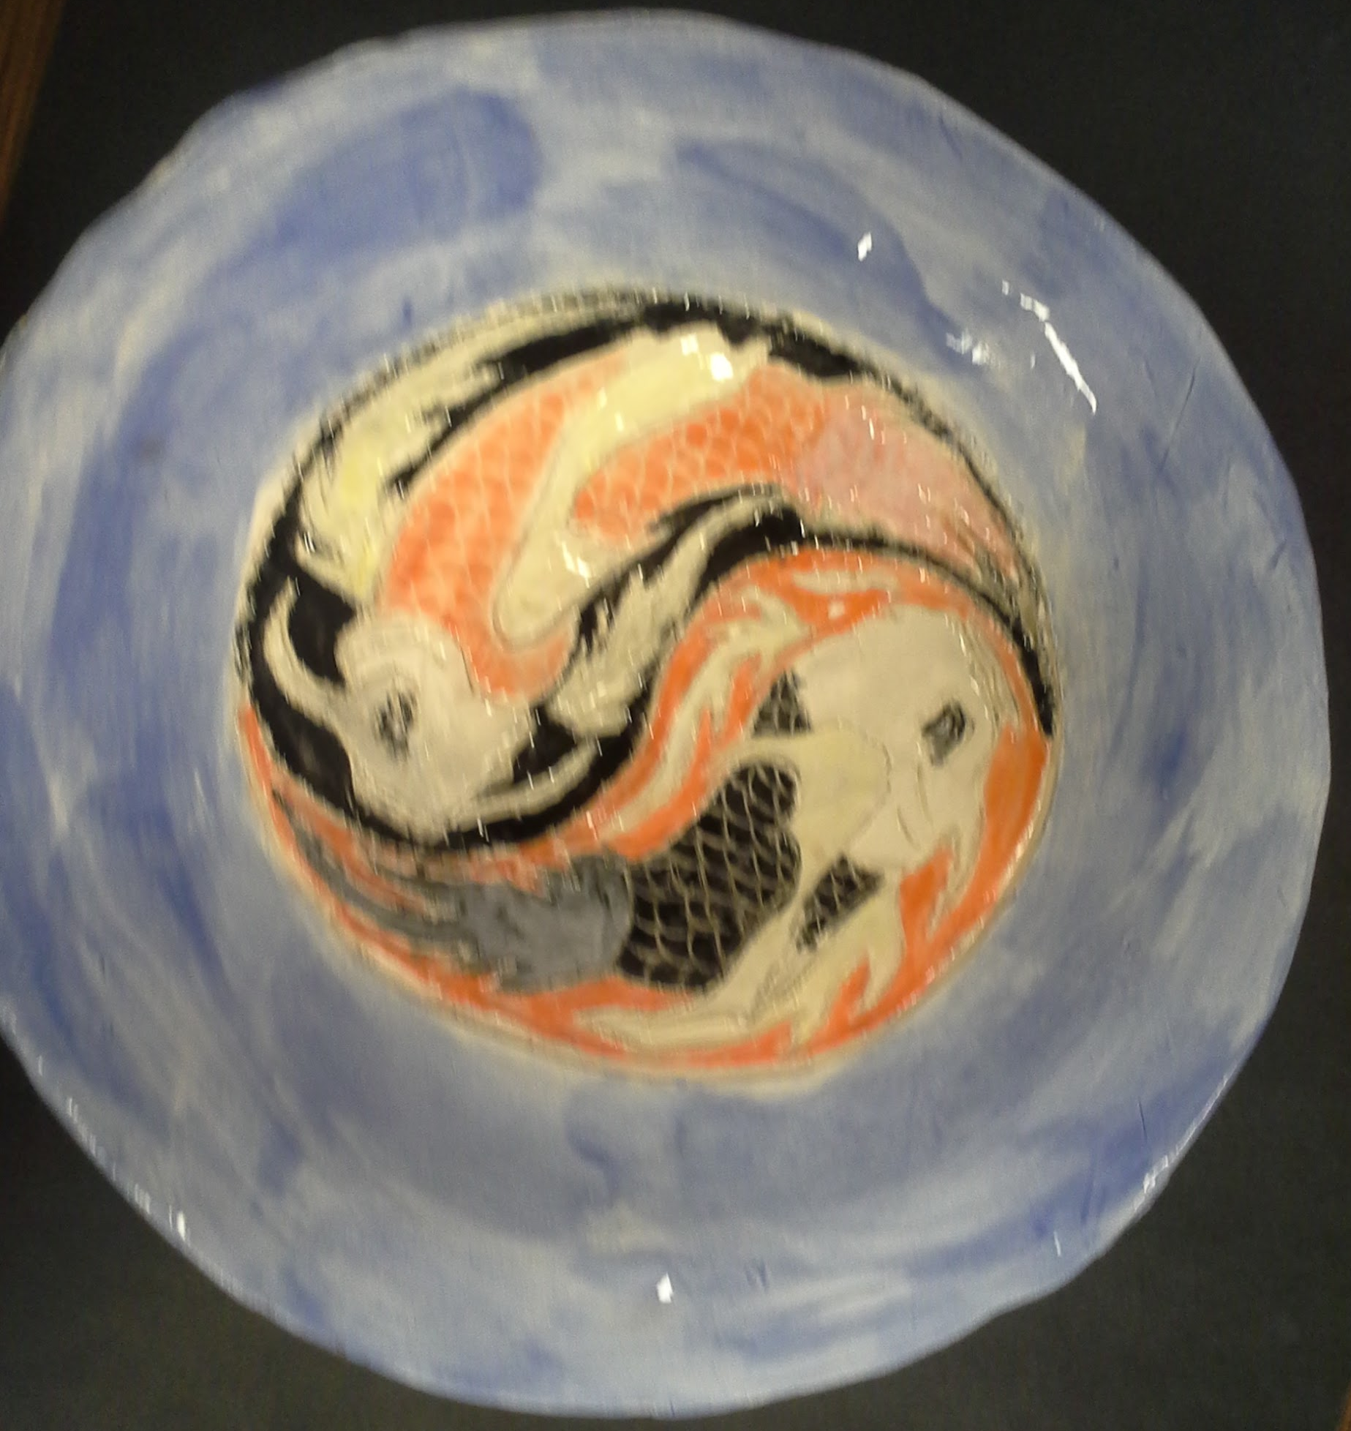

Slide 23
Set work
Background work on the ferris wheel and roller coaster
White paint on black painted wood
Massive
Contrast, Emphasis, Etc.
Ms. Murphy’s design example
Give the feeling that the park was abandoned and dark

Slide 24
N/A

Slide 25
Tea Pot Greenware
Flower Pot
Clay
Unknown
Simple design
Ms. Murphy’s example
Make a teapot that actually looks like a teapot

Slide 26
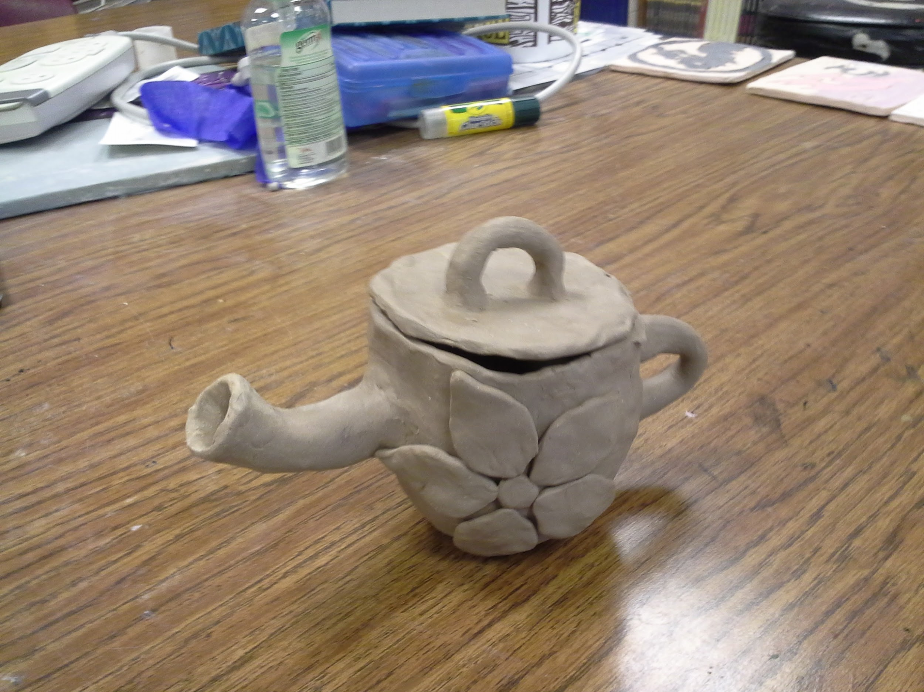
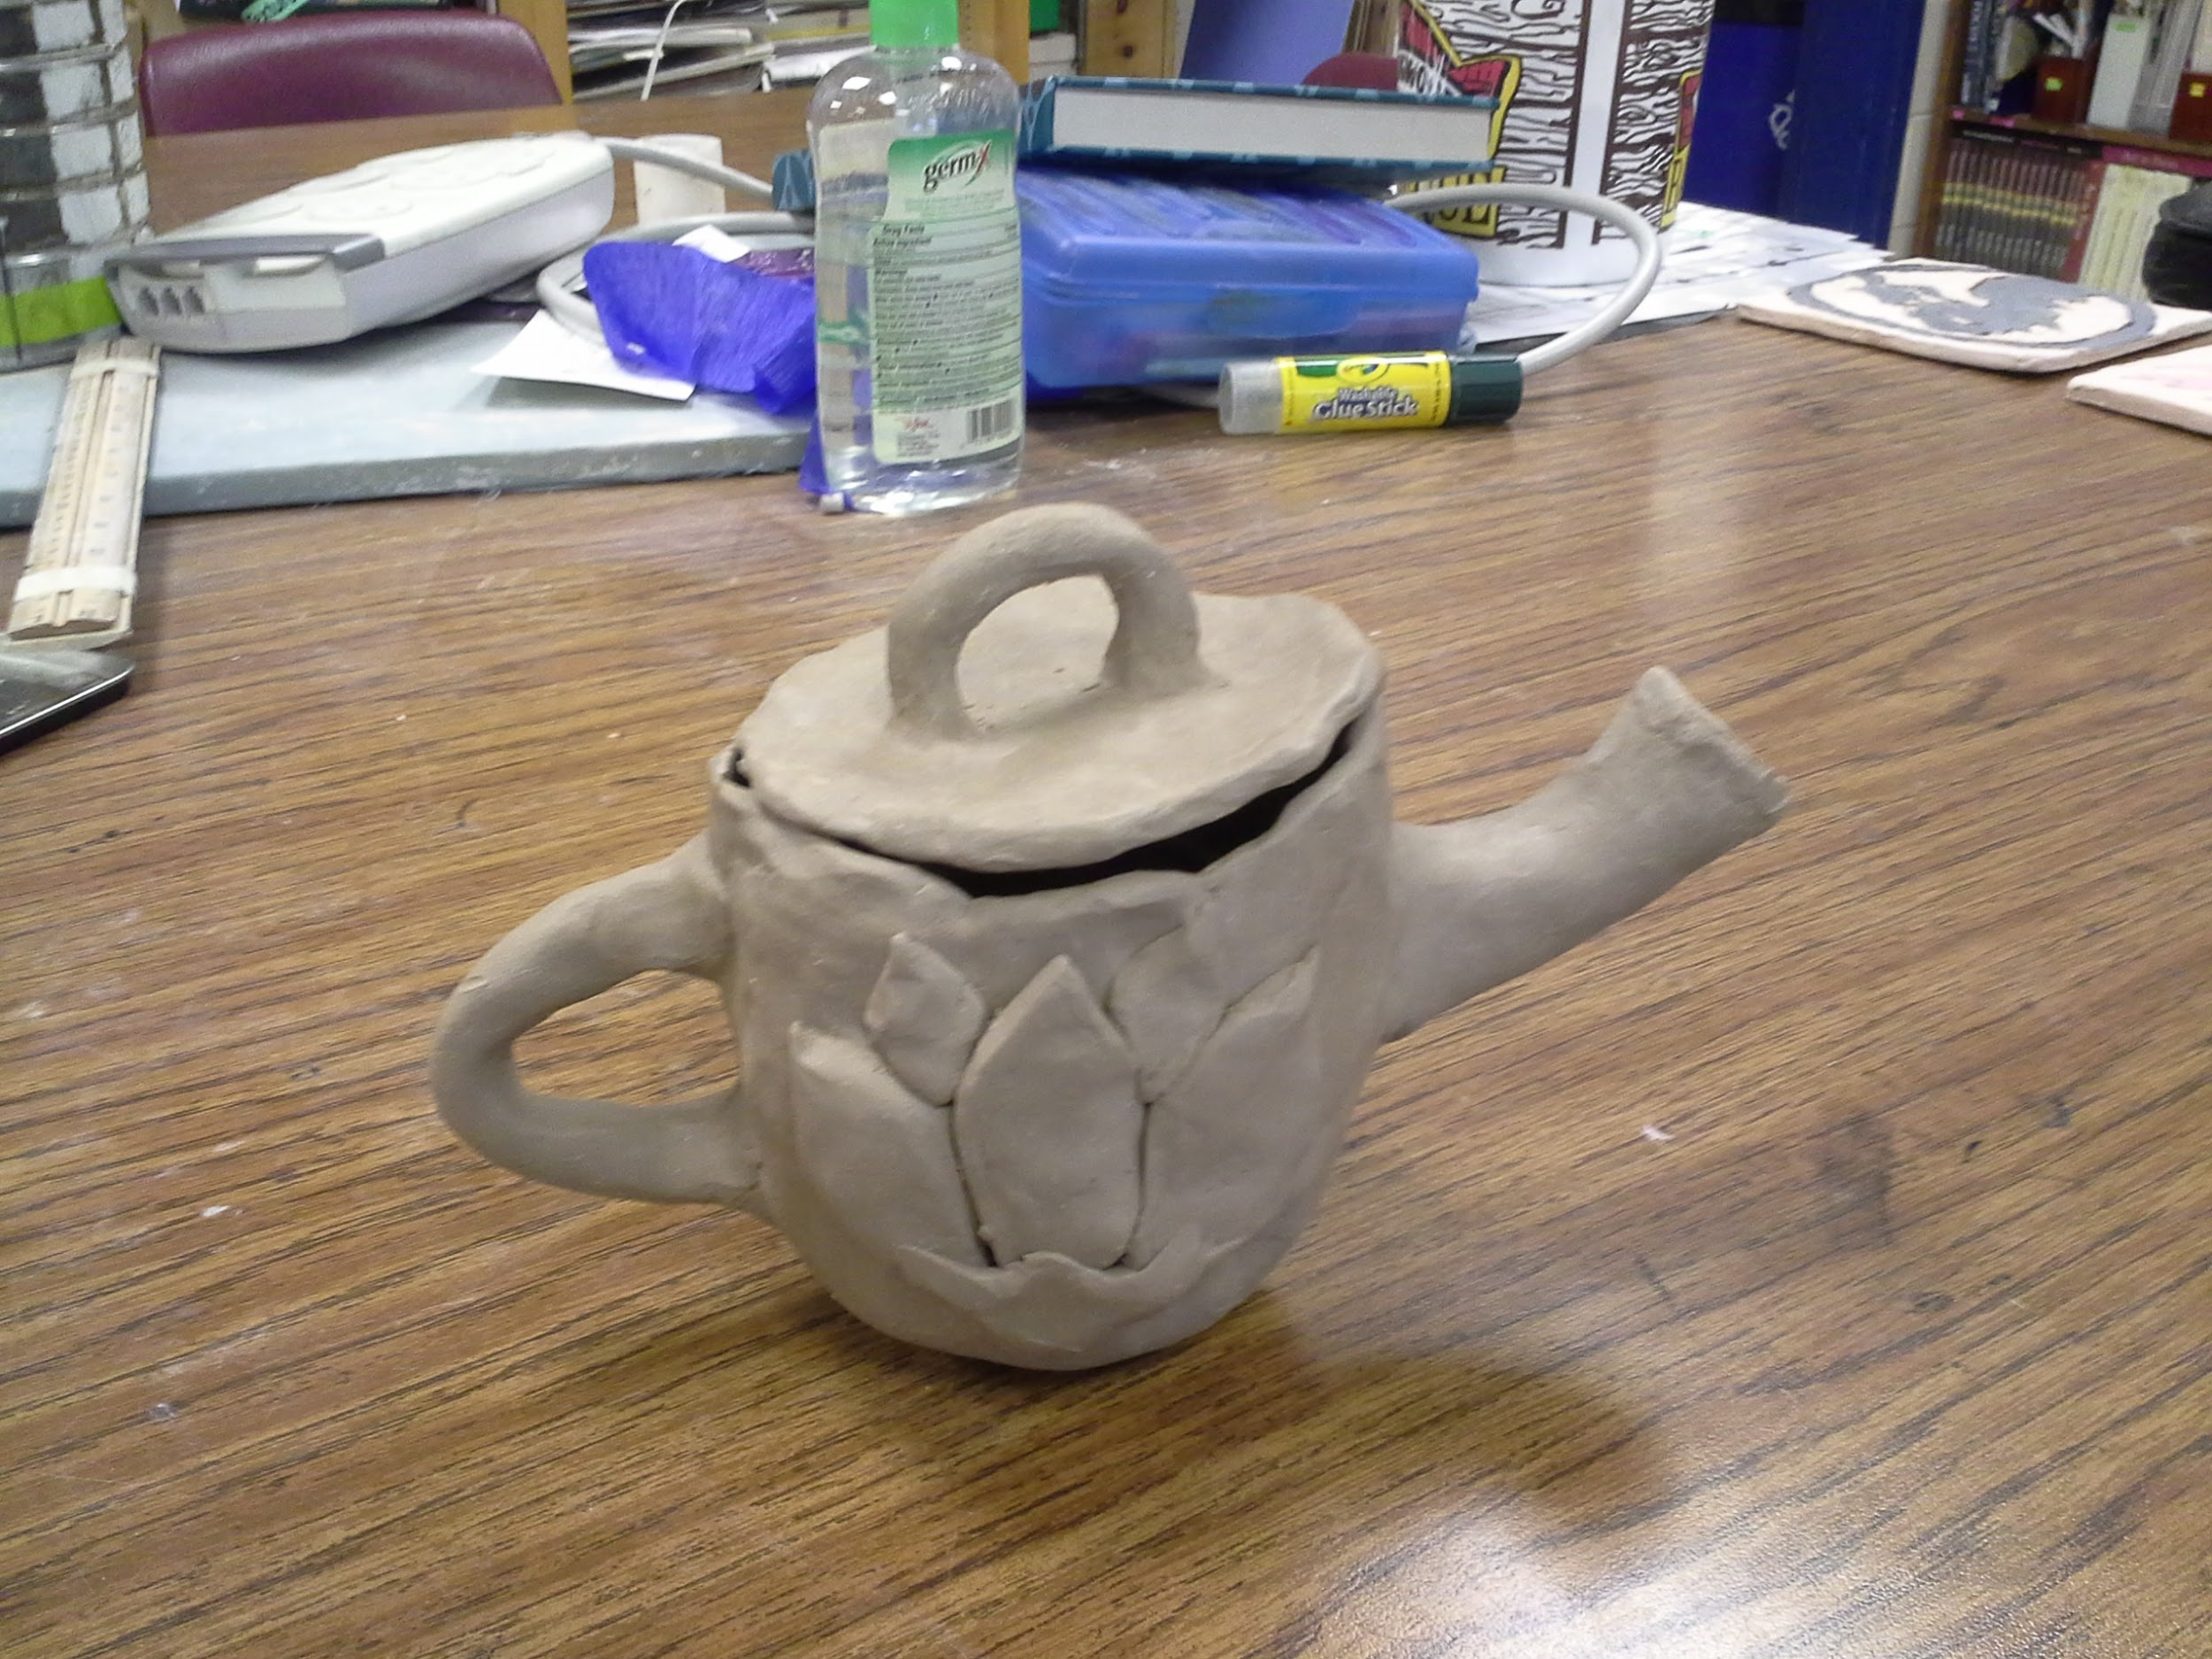
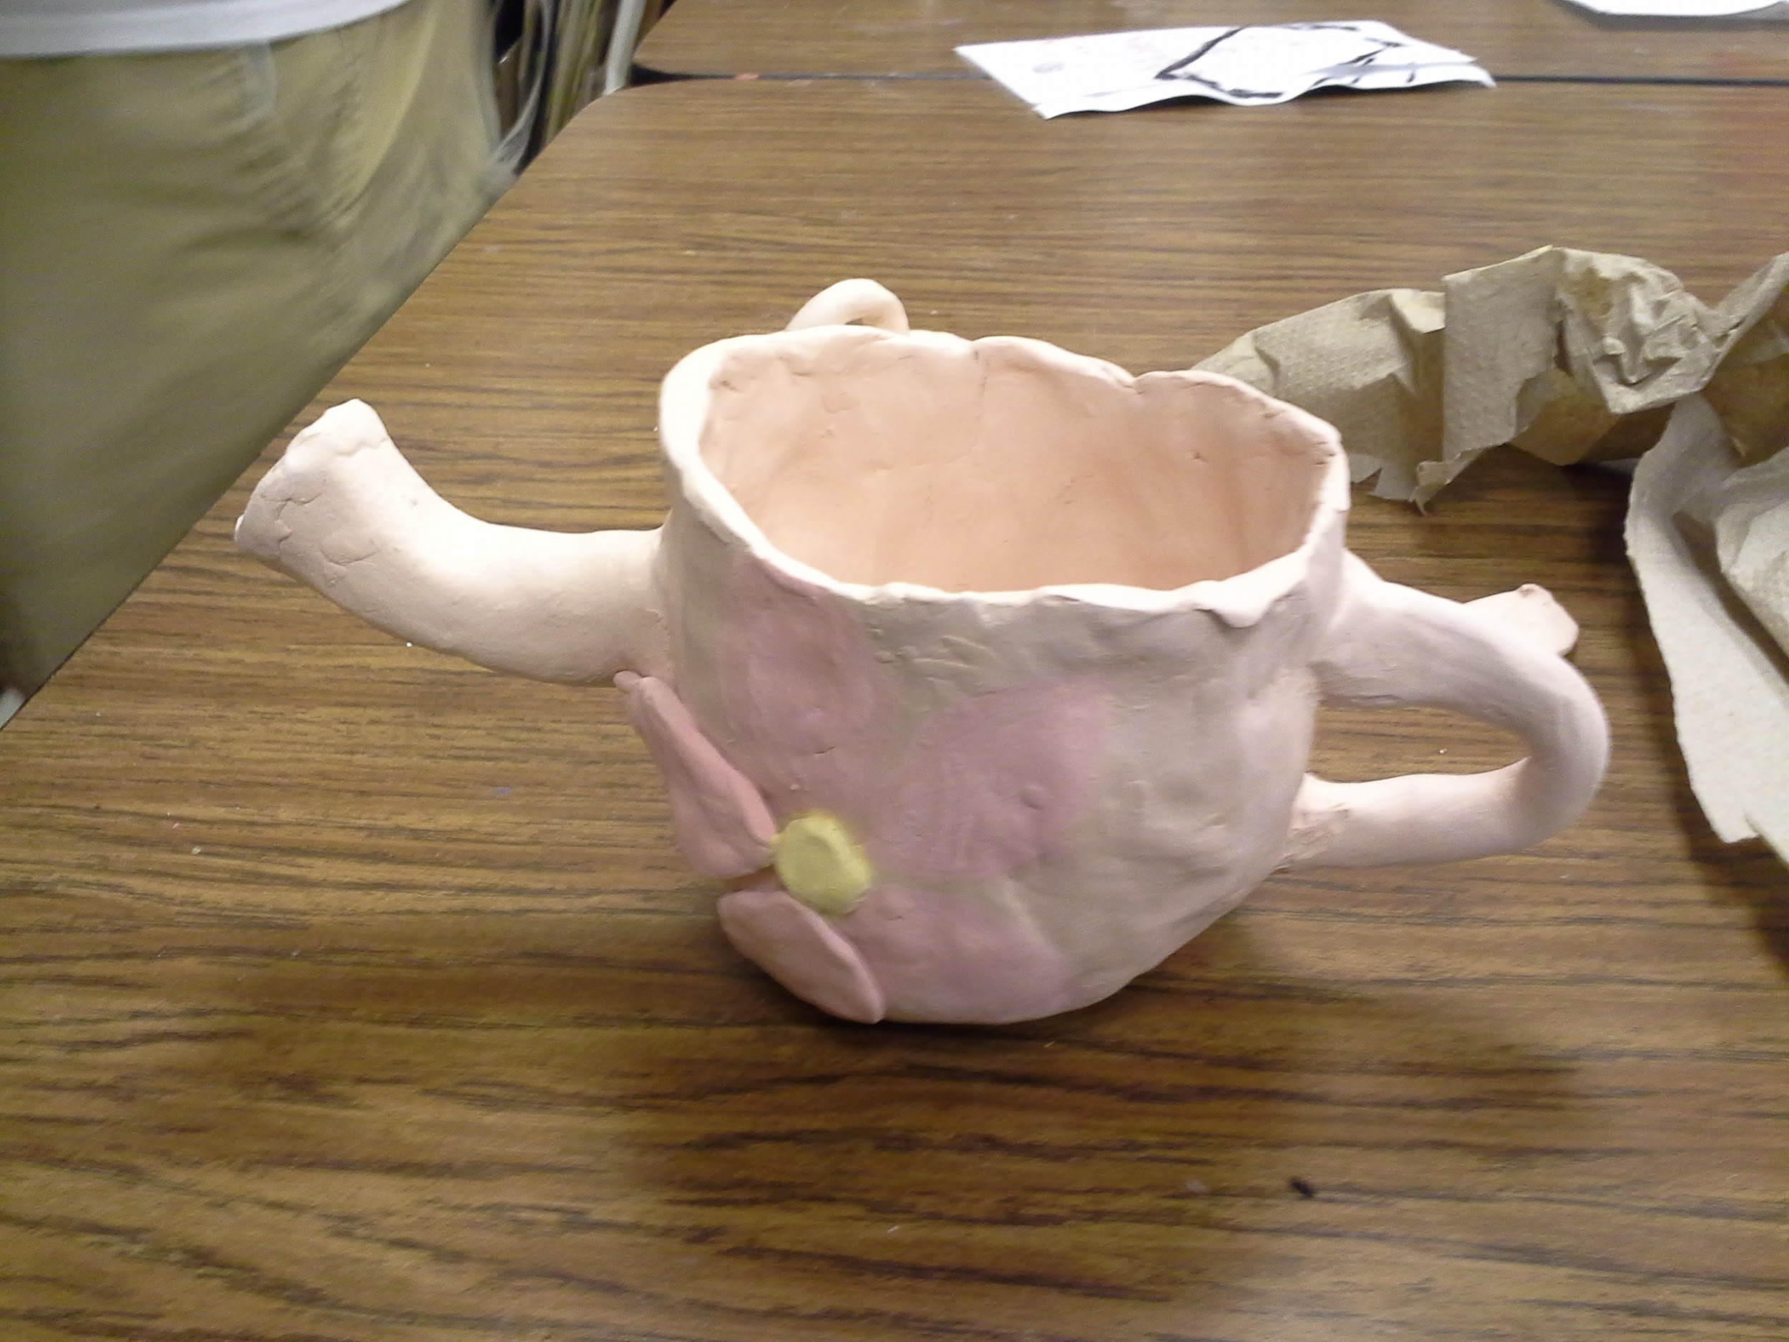

Slide 27
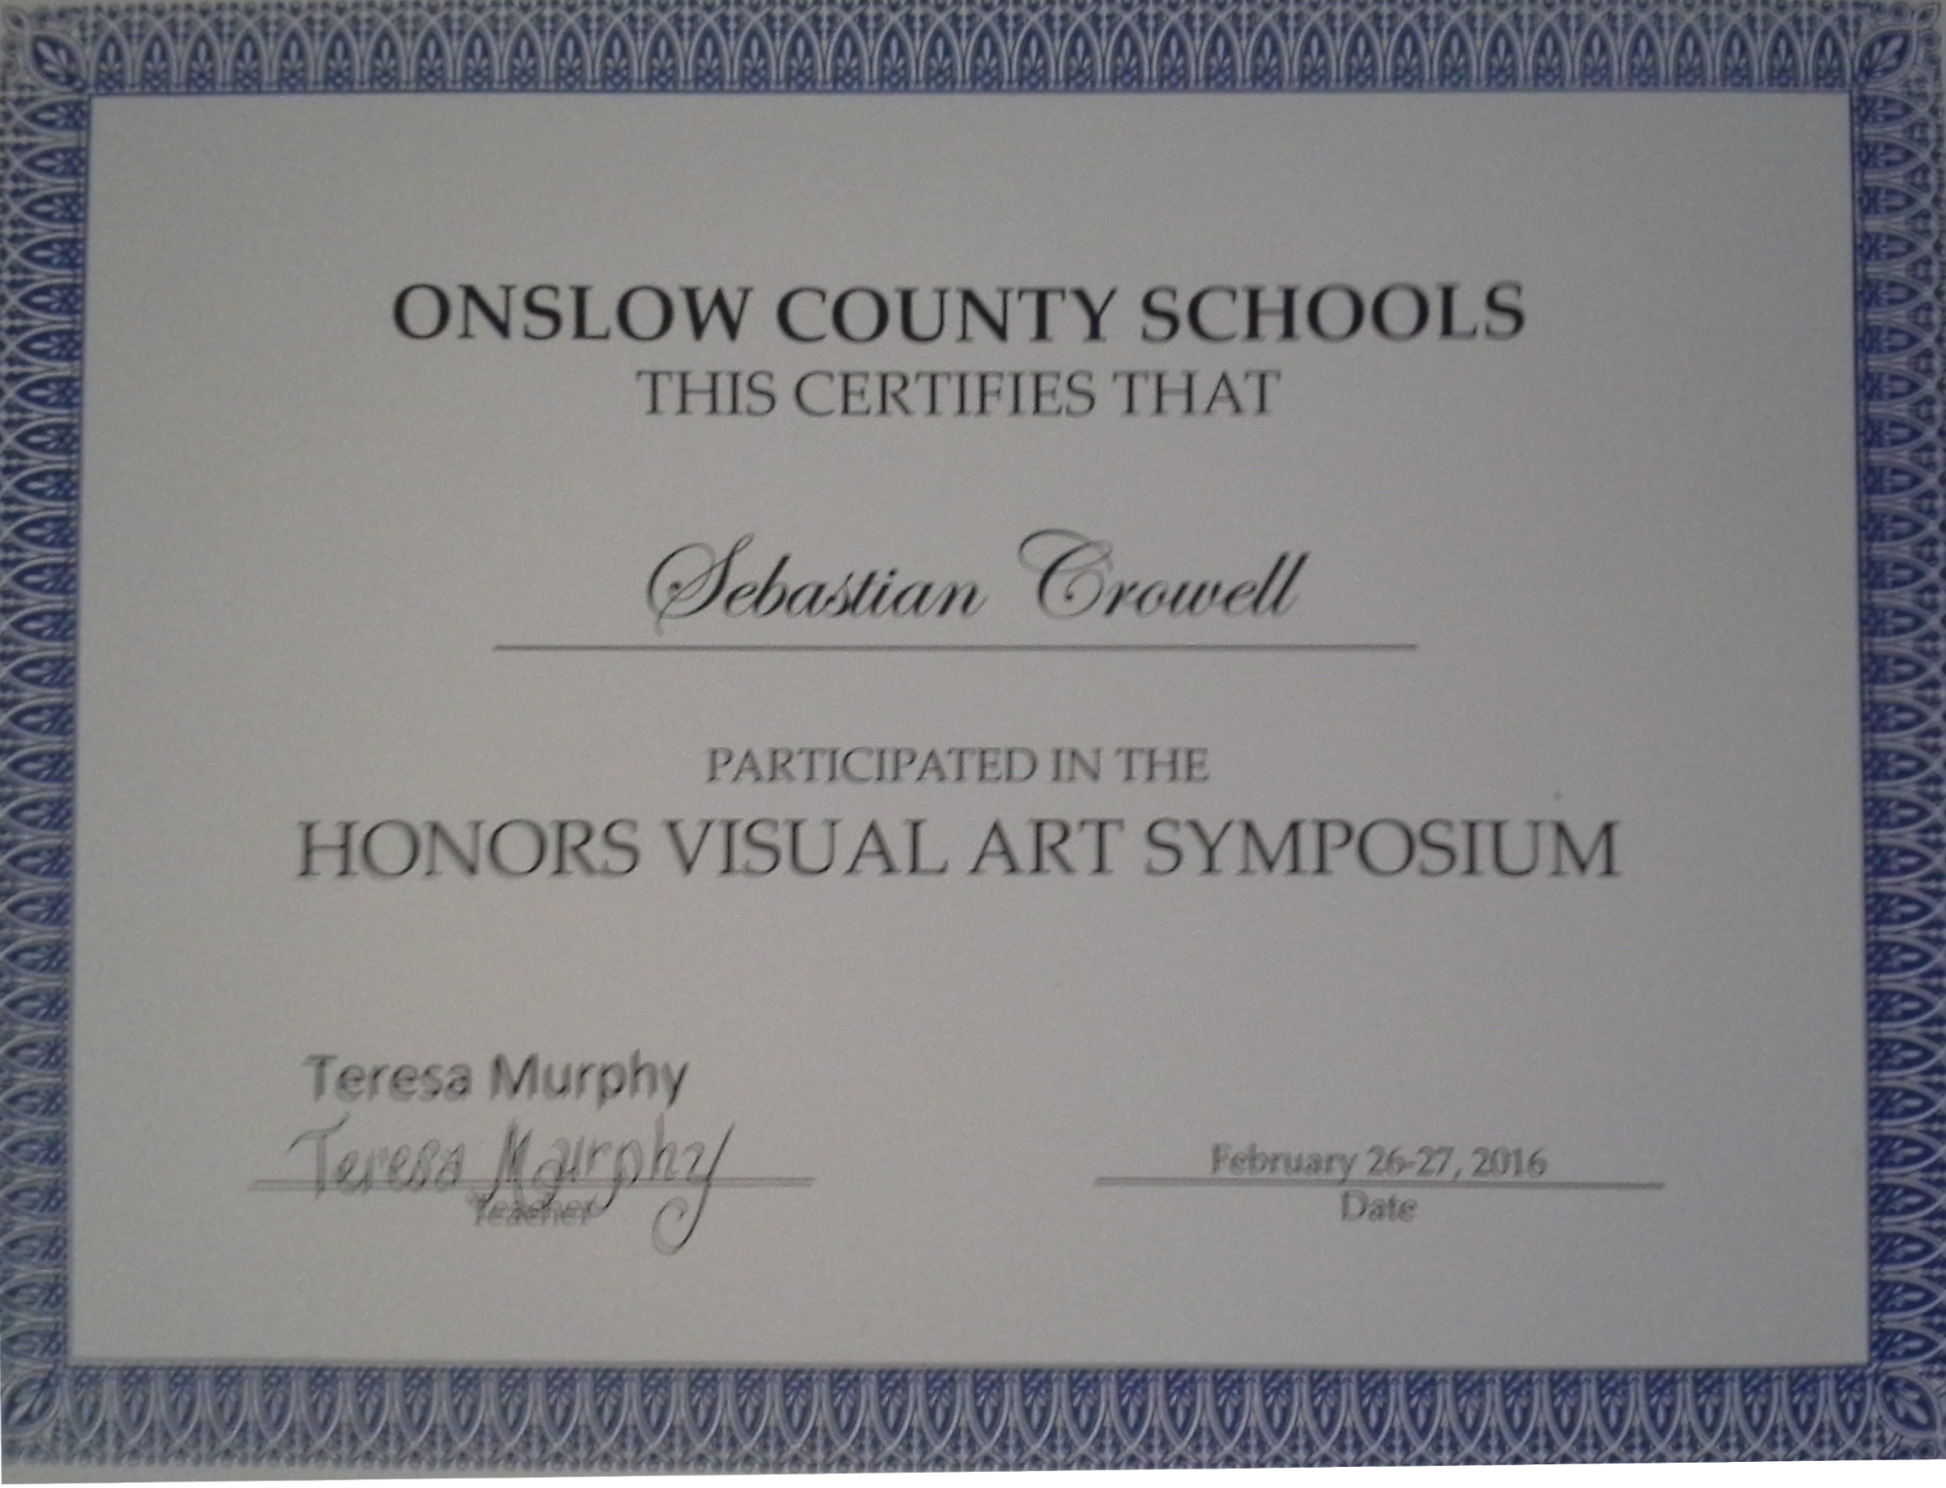
Awards
All-County Art
Art featured in the Council for the Arts

